Slide 1
Today's Stuff
9-10: clouds and distributed systems
10-12: microservices and containers
1-2: more on containers are orchestration and actor model/service fabric
2-3: architectural evolution with radical scale: massive online gaming
3-4: security and distributed systems, including IoT

Slide 2
Today’s Narrative
You need to know the choices you face because everything is faster. We’ll do that.
Microservices
Containers
Orchestration systems
Live monitoring and testing
Service Fabric and the Actor Model
You’ll need to know how to navigate those choices. We’ll do that, too. Arguments welcome.
Migrate – do not sprint -- toward agile devops workflows and microservice architecture approach
Automate, orchestrate, monitor
Get the little things right
Choose a great partner, but have more than one
Security first

Slide 3
Setting the Table
Recent History

Slide 4
Clouds: Azure, Amazon, Google... and the rest.
Whirlwind tour

Slide 5
Point: if things fail, design for failure
Story: disks fail constantly. In a datacenter, disk are constantly failing. You should expect that each component of your application could hit that disk at any time. Your components should think that’s normal – it’ll happen to them.
Chaos monkey!

Slide 6
Point: Do you wash your rental car?
I didn’t think so….
So, if you’re renting computers, why don’t you burn them up?
RUN YOUR MACHINERY HARD.
Containers
Chaos Monkey
Failure detection
STORAGE strategy: distributed redis into blobs, json blobs (“documents” -- mongodb) and sql backends
Etc.

Slide 7
Point: Smallest possible partitioned resource
VMs should be smallest
OS should be smallest
Bunches of storages with partition and retry policies
Benefits:
Fine grained scaleout and scalein
Each failure much smaller portion of entire load
Cost (Duh)

Slide 8
Point: Scale-up works if…
Stackoverflow.com
The example that proves the rule.

Slide 9
Point: CAP theorem pushes us towards
We must choose between the three; experience in distributed systems teaches us that C(onsistency) is not one of the top two
With one exception: When it is the point of the application. Only then.

Slide 10
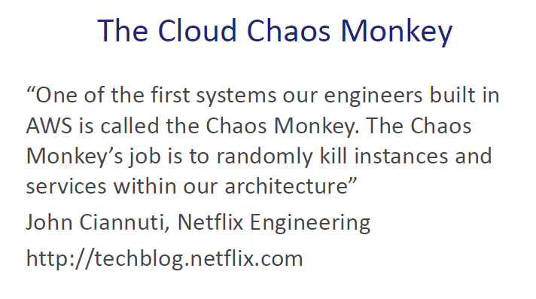
The Chaos Monkey Lives!!!

Slide 11
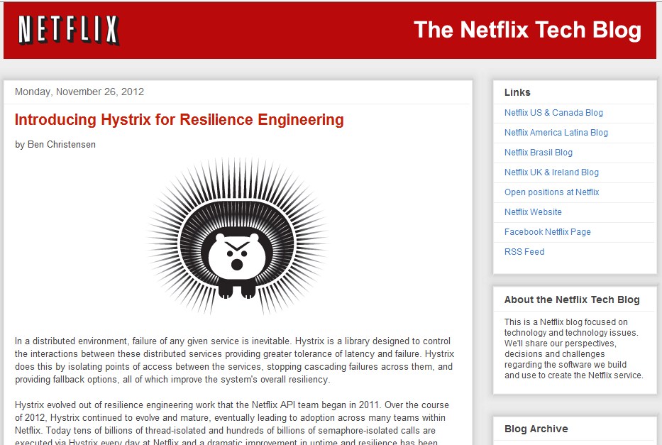

Slide 12



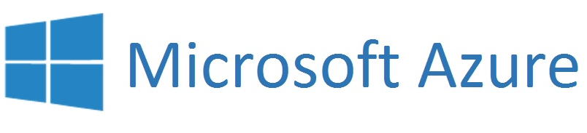
Point: The Clouds are one big machine

Slide 13

Point: The Clouds are one big machine
Docker Client

Slide 14
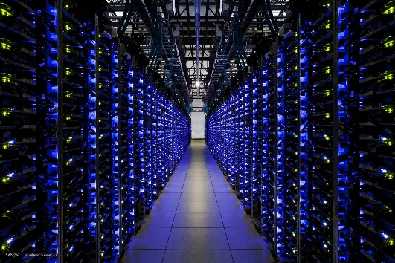
Point: The Clouds are one big machine
Docker Client
Your own cloud

Slide 15
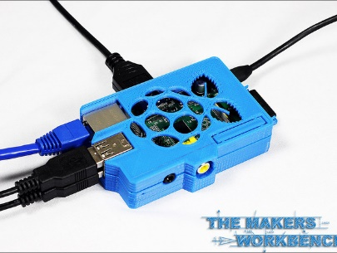
Point: The machines are one big machine
Docker Client
Your own cloud

Slide 16
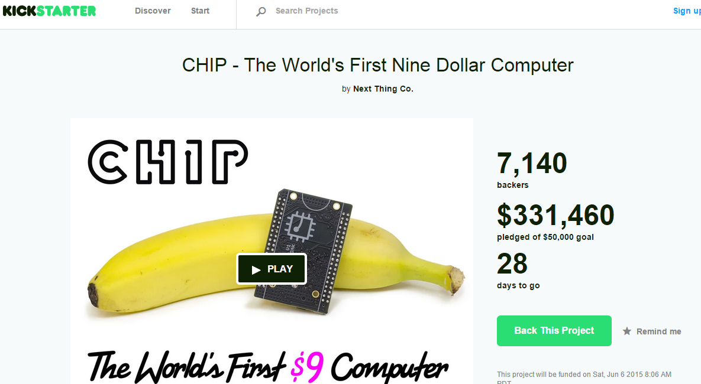
Think I’m kidding?
https://www.kickstarter.com/projects/1598272670/chip-the-worlds-first-9-computer

